Slide 1

Understanding Exemptions

Slide 2
What is an Exemption?
Per the Texas Property Tax Code an exemption is a deduction from taxable value
Texas offers a variety of partial or complete exemptions from local property tax
Property is taxable unless the owner shows that it meets the legal requirements for an exemption
Typically, the property owner has to file an application for the exemption

Slide 3
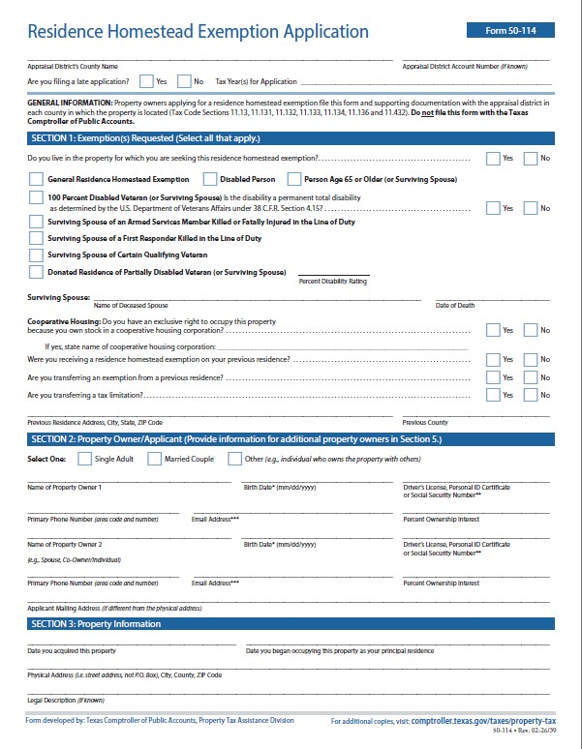
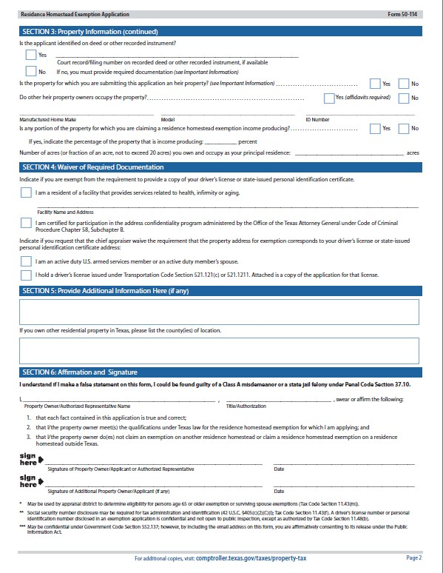
Residence Homestead Application

Slide 4
Homestead Exemption
An adult is entitled to exemption from taxation by a school district of $140,000 of the appraised value of the adult’s residence homestead & $5,000 for Road and Bridge.
Other taxing units may approve an exemption not exceeding 20%

Slide 5
Limitations on Residence Homestead
Generally, the qualification date is January 1st however, you may be eligible for a homestead as soon as you acquire a property if :
- The property doesn’t have an exemption as of January 1st
- You are not claiming an exemption on another property as of January 1st
- You meet all other qualification
When a homestead is in place it will only allow the apprised value of the property to increase 10% from the preceding tax year.

Slide 6
Qualifying for a Homestead
Must own & currently occupy the property
Not be claiming a homestead exemption on another property
Must have a Valid Texas State driver’s License or Texas State ID matching the physical address of the residence

Slide 7
Over 65 Exemption
This exemption is for homeowners age 65 and older
Lowers the taxable value of your property by $60,000 for school districts
Establishes a tax ceiling that limits school taxes to the amount paid in the year that you first qualified (unless new value is added)
Allows you to transfer the percentage of school taxes paid to another homestead in Texas if you move

Slide 8
Qualifying for Over 65 Exemption
You must be 65 years or older
Must own & currently occupy the property
You cannot claim this exemption on other property

Slide 9
Surviving Spouse
Of a recipient of the over 65 exemption
To Qualify:
You must be 55 years or older when your spouse died
Must have been on the deed or supply a legal document transferring ownership
Your spouse was receiving this exemption or would have qualified for it the year they died

Slide 10
Disabled Person Exemption
This exemption may apply if you meet the Social Security Administration standards for disability, even if you’re not receiving benefits
It will lower the taxable value by $60,000 for school district taxes
Establishes a tax ceiling that limits school taxes to the amount you paid in the year that you first qualify

Slide 11
100% Disabled Veteran Exemption
A disabled veteran who has been awarded by the United States Department of Veterans Affairs or its successor 100% disability compensation due to a service-connected disability and a rating of 100% is entitled to an exemption from taxation of the total appraised value of the veteran's residence homestead.
To qualify:
Must own & currently occupy the property
Provide a copy of award letter from VA
Must have a Valid Texas State driver’s License or Texas State ID matching the physical address of the residence

Slide 12
Surviving Spouse
Of a 100% Disabled Veteran
To Qualify:
Must not be remarried
Continue to own and occupy the property
Must provide a surviving spouse letter from Veteran Affairs office with all required information

Slide 13
Disabled Veteran
A disabled veteran is entitled to an exemption from taxation of a portion of the assessed value of a property the veteran owns
Exemption Amount: | Disability rating of at least: | But less than:
$5,000 | 10% | 30%
$7,500 | 30% | 50%
$10,000 | 50% | 70%
$12,000 | 70% & over

Slide 14
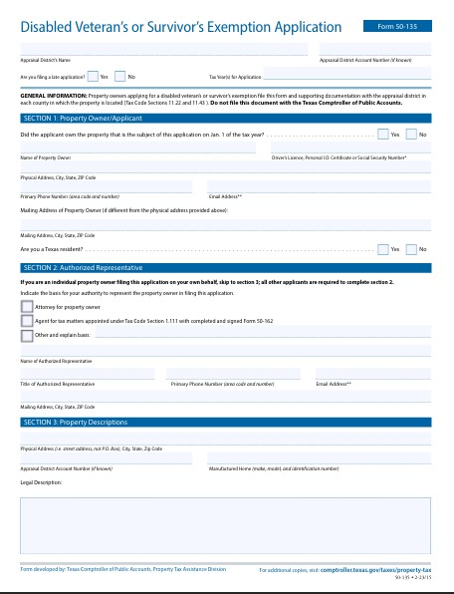
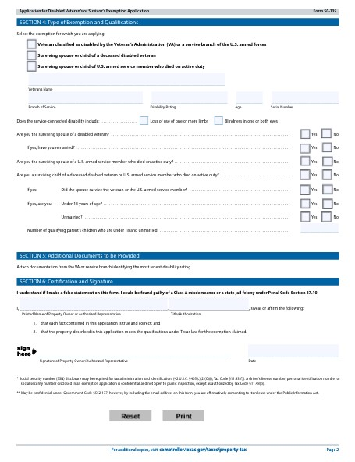
Disabled Veteran Application

