Slide 1

Protesting Property

Slide 2
Right of Protest: Section 41.41
A property owner is entitled to protest before the appraisal review board for the following reasons:
Determination of the appraised value of the owner’s property
Unequal appraisal of the owner’s property
Inclusion of the owner’s property on the appraisal records
Denial to the property owner in whole or part of exemption
Circuit Breaker limitation on appraised value
Determination that the owners’ land does not qualify for appraisal (1-D-1, 1-D & Wildlife)
Identification of the taxing units in which the owner's property is taxable in the case of the appraisal district's appraisal roll
Any other action of the chief appraiser, appraisal district, or appraisal review board that applies to and adversely affects the property owner

Slide 3
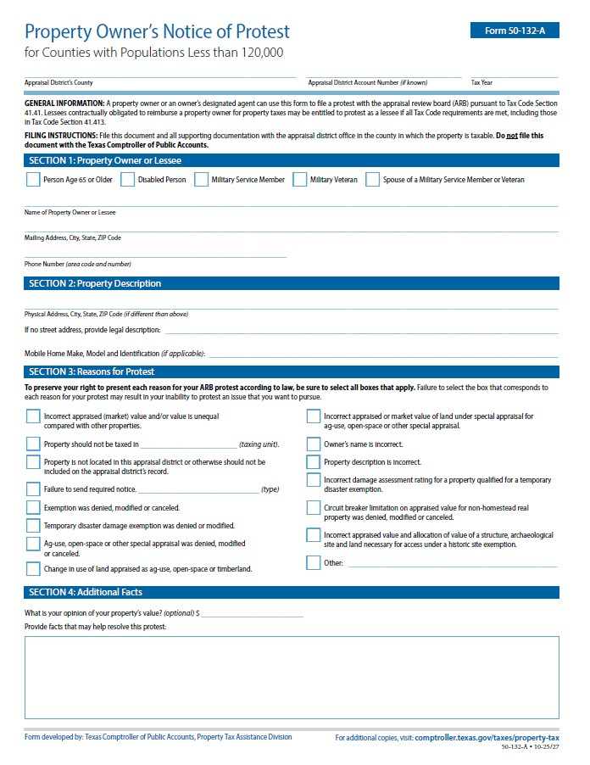
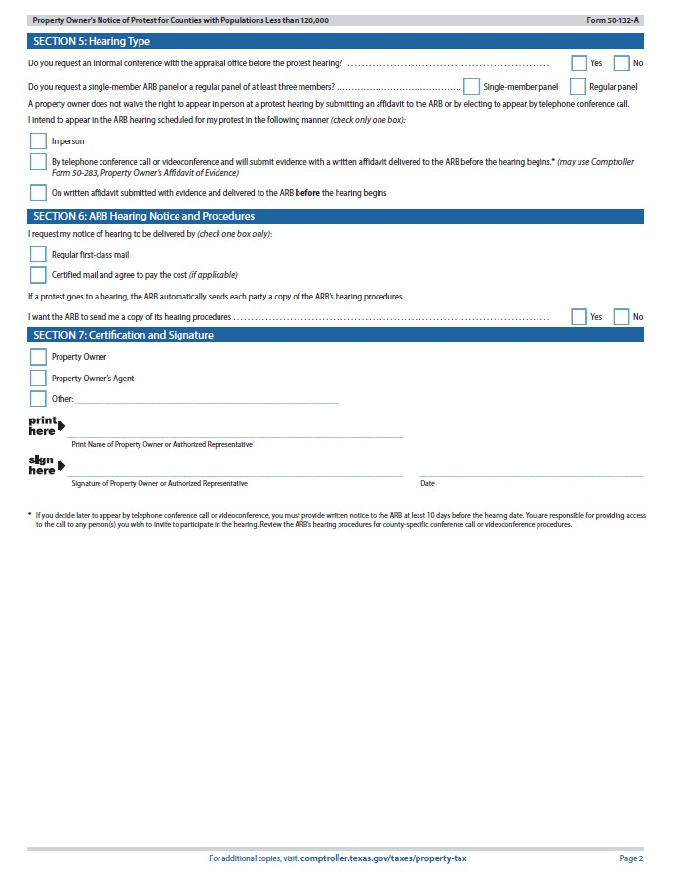
Notice of Protest
Form 50-132-A Property Owner’s Notice of Protest

Slide 4
Submitting a Protest
Ways to File a Notice of Protest
A Property owner can file a Notice of Protest for the tax year as early as January 1st not later than May 15 or the 30th day after the date that notice to the property owner was delivered to the property owner.
Turned in person to the DeWitt County Appraisal District at 103 E. Bailey St. Cuero, TX 77954
Emailed to information@dewittcad.org
Mailed to 103 E. Bailey St. Cuero, TX 77954

Slide 5
What is the process once I protest?
You will be contacted to discuss the issues of your protest informally with representatives of the appraisal district and if an agreement cannot be made you will be scheduled to appear Infront of the Appraisal Review Board and a final determination will be made.

Slide 6
What is an informal?
An informal is elected by the property owner to have a meeting with an appraiser from the appraisal district. This is meant to give the property owner an opportunity to provide any evidence they have regarding the protest and discuss with an appraiser. If you and the appraiser can come to an agreement on your protest case, your case will be considered closed and you will not have to appear before the Appraisal Review Board for the formal hearing. This will be the final determination on the case. You do not have the option to take further action if you are unsatisfied with the outcome.

Slide 7
What is a Formal Hearing?
If a taxpayer does not elect for an informal or did not come to an agreement with the appraisal district you will be scheduled to appear Infront of the Appraisal Review Board. A formal hearing before the ARB is conducted very much like a court case. The ARB sets its own procedures with guidelines from the State Comptroller’s Office. After formal introduction of the parties and the property involved, the ARB will hear evidence from the property owner and the Appraisal District and make a judgment based on the evidence presented.

Slide 8
Hearing Procedures
Each party, the property owner and the Appraisal District appraiser, will have approximately 3-5 minutes to present their case and evidence at the hearing. Most ARB hearings take approximately 15 minutes and the property owner will know the ARB’s recommendation before they leave the hearing. After a recommendation is made by the ARB panel and subsequently approved by a quorum of the entire Board, a written Notice of Final Order is sent by mail to you or your agent.

Slide 9
What should be brought to a protest hearing?
The property owner will need to bring evidence to support their protest such as sales of comparable homes in your neighborhood, the purchase price of your home if obtained recently, photographs of your home that may reflect any negative conditions such as cracks, flood damage, and so forth.
By law, a copy of all evidence submitted to the ARB must be retained for public record; therefore, paper is preferred. It is also recommended that you create extra copies for your records as well. Only hard copies of your evidence is allowed to be submitted. Electronic evidence is not permitted.
Hearings are conducted the Dewitt County Appraisal District located at 103 E. Bailey, Cuero, TX 77954

Slide 10
What happens if I don’t attend the formal Hearing?
Can a formal hearing be Rescheduled?
Your protest will be dismissed if you do not appear in person.
You may request that the ARB Chairperson reopen the hearing by sending a letter within 4 days of the dismissal citing the good cause reason for failure to appear.
An alternative to not appear in person is a valid Affidavit can be submitted to be read in on your behalf or for you to have a hearing via telephone.
Per Section 41.45 (e) On Request made to the Appraisal Review Board before the date of the hearing , a property owner who has not designated an agent under Section 1.111 to represent the owner at the hearing is entitled to one postponement of the hearing to a later date without showing cause. You Reschedule by calling the office at (361)-275-5733.

Slide 11
What happens after the formal hearing?
At the hearing, the ARB will immediately inform you of the final determination of your protest case. Shortly thereafter you will receive by mail, a written order from the ARB reflecting the final determination that was approved at your formal hearing. Included with the written order will be information on what options you have if you wish to appeal that final determination.

