Slide 1

Business Personal Property

Slide 2
What is Business Personal Property?
  BPP is tangible property owned and used by a business for the production of income. BPP is generally movable and is not affixed to or associated with the real property (structures and land). Like real property, BPP is taxable in Texas and is valued by the central appraisal districts. BPP is primarily composed of fixed assets and inventory.

Slide 3
What are Fixed Assets?
Also known as “use” assets, they're items commonly described as furniture, machinery, signs, some leasehold, office equipment, electronics, computer & data equipment, vehicles & trailers, aircraft, watercraft and any other kind of asset that is held by its owner to be used for the purpose it was created.

Slide 4
What is Inventory & Supplies?
BPP that is held by a commercial or industrial enterprise for consumption, processing or sale. Inventory can also be described as raw materials, foods in process, finished goods, goods held for sale, consigned goods & floor planned goods.

Slide 5
What is a Rendition?
Who has to Render?
A rendition is a form that provides information about property that you own. The appraisal district uses the information you provide to appraise your property for taxation.
Owners of tangible personal property that is used for the production of income
Owners of property on which an exemption has been cancelled or denied
Owners who have been formally notified by the chief appraiser that they must render.

Slide 6
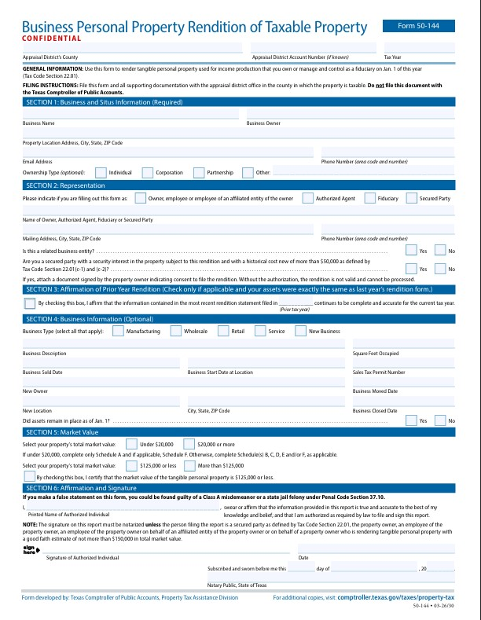
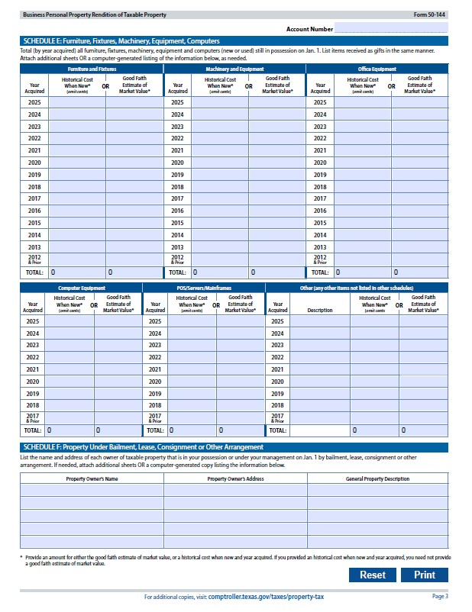
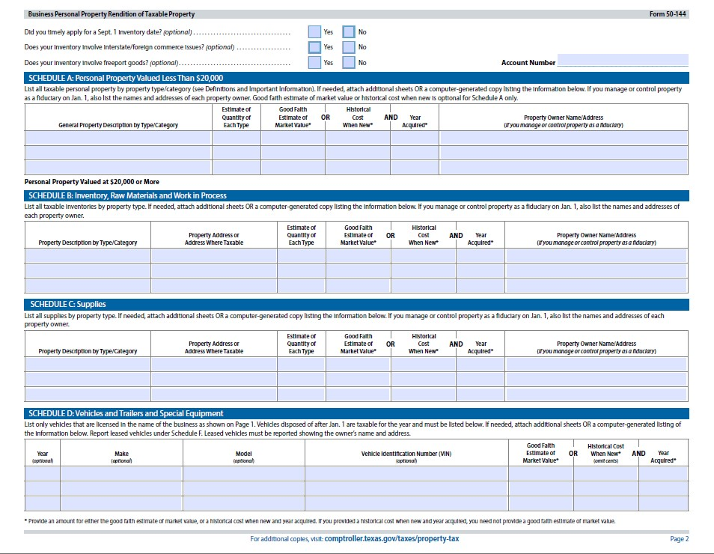
What form needs to be file for a rendition?
Form 50-144 : Business Personal Property Rendition of Taxable Property

Slide 7
When must a Rendition be filed?
Ways to file a Rendition:
The last day to file a rendition is April 15th.
If a Rendition is mailed, it must be postmarked before or on April 15th
Turned in person to the DeWitt County Appraisal District at 103 E. Bailey St. Cuero, TX 77954
Emailed to information@dewittcad.org
Mailed to 103 E. Bailey St. Cuero, TX 77954

Slide 8
What information should be Rendered?
Parcel ID
Location
General Description (information to identify the property)
Quantity of items
Date of acquisition
Original cost

Slide 9
Section 3
By checking this box, that indicates the value for the current year tax is the same as the previous tax year

Slide 10
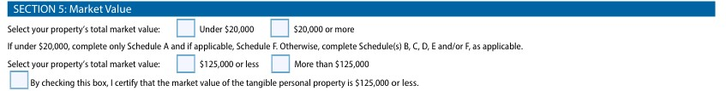
Section 5
On the first set of boxes, you must indicate if the market value is more than $20,000 or less than $20,000.
On the second set of boxes, you must also indicate if the market value is less than $125,000 or more than $125,000 for exemption purposes.

Slide 11
Income-Producing Tangible Personal Property Exemption
A person is entitled to an exemption from taxation by a taxing unit of the tangible personal property held or used for income production of the appraised value of $125,000. (Tax Code Section 11.145).

Slide 12
Penalties
The chief appraiser must impose a penalty on a person who fails to timely file a required rendition statement or property report in an amount equal to 10 percent of the total amount of taxes imposed on the property for that year by taxing units participating in the appraisal district.

